Slide 1
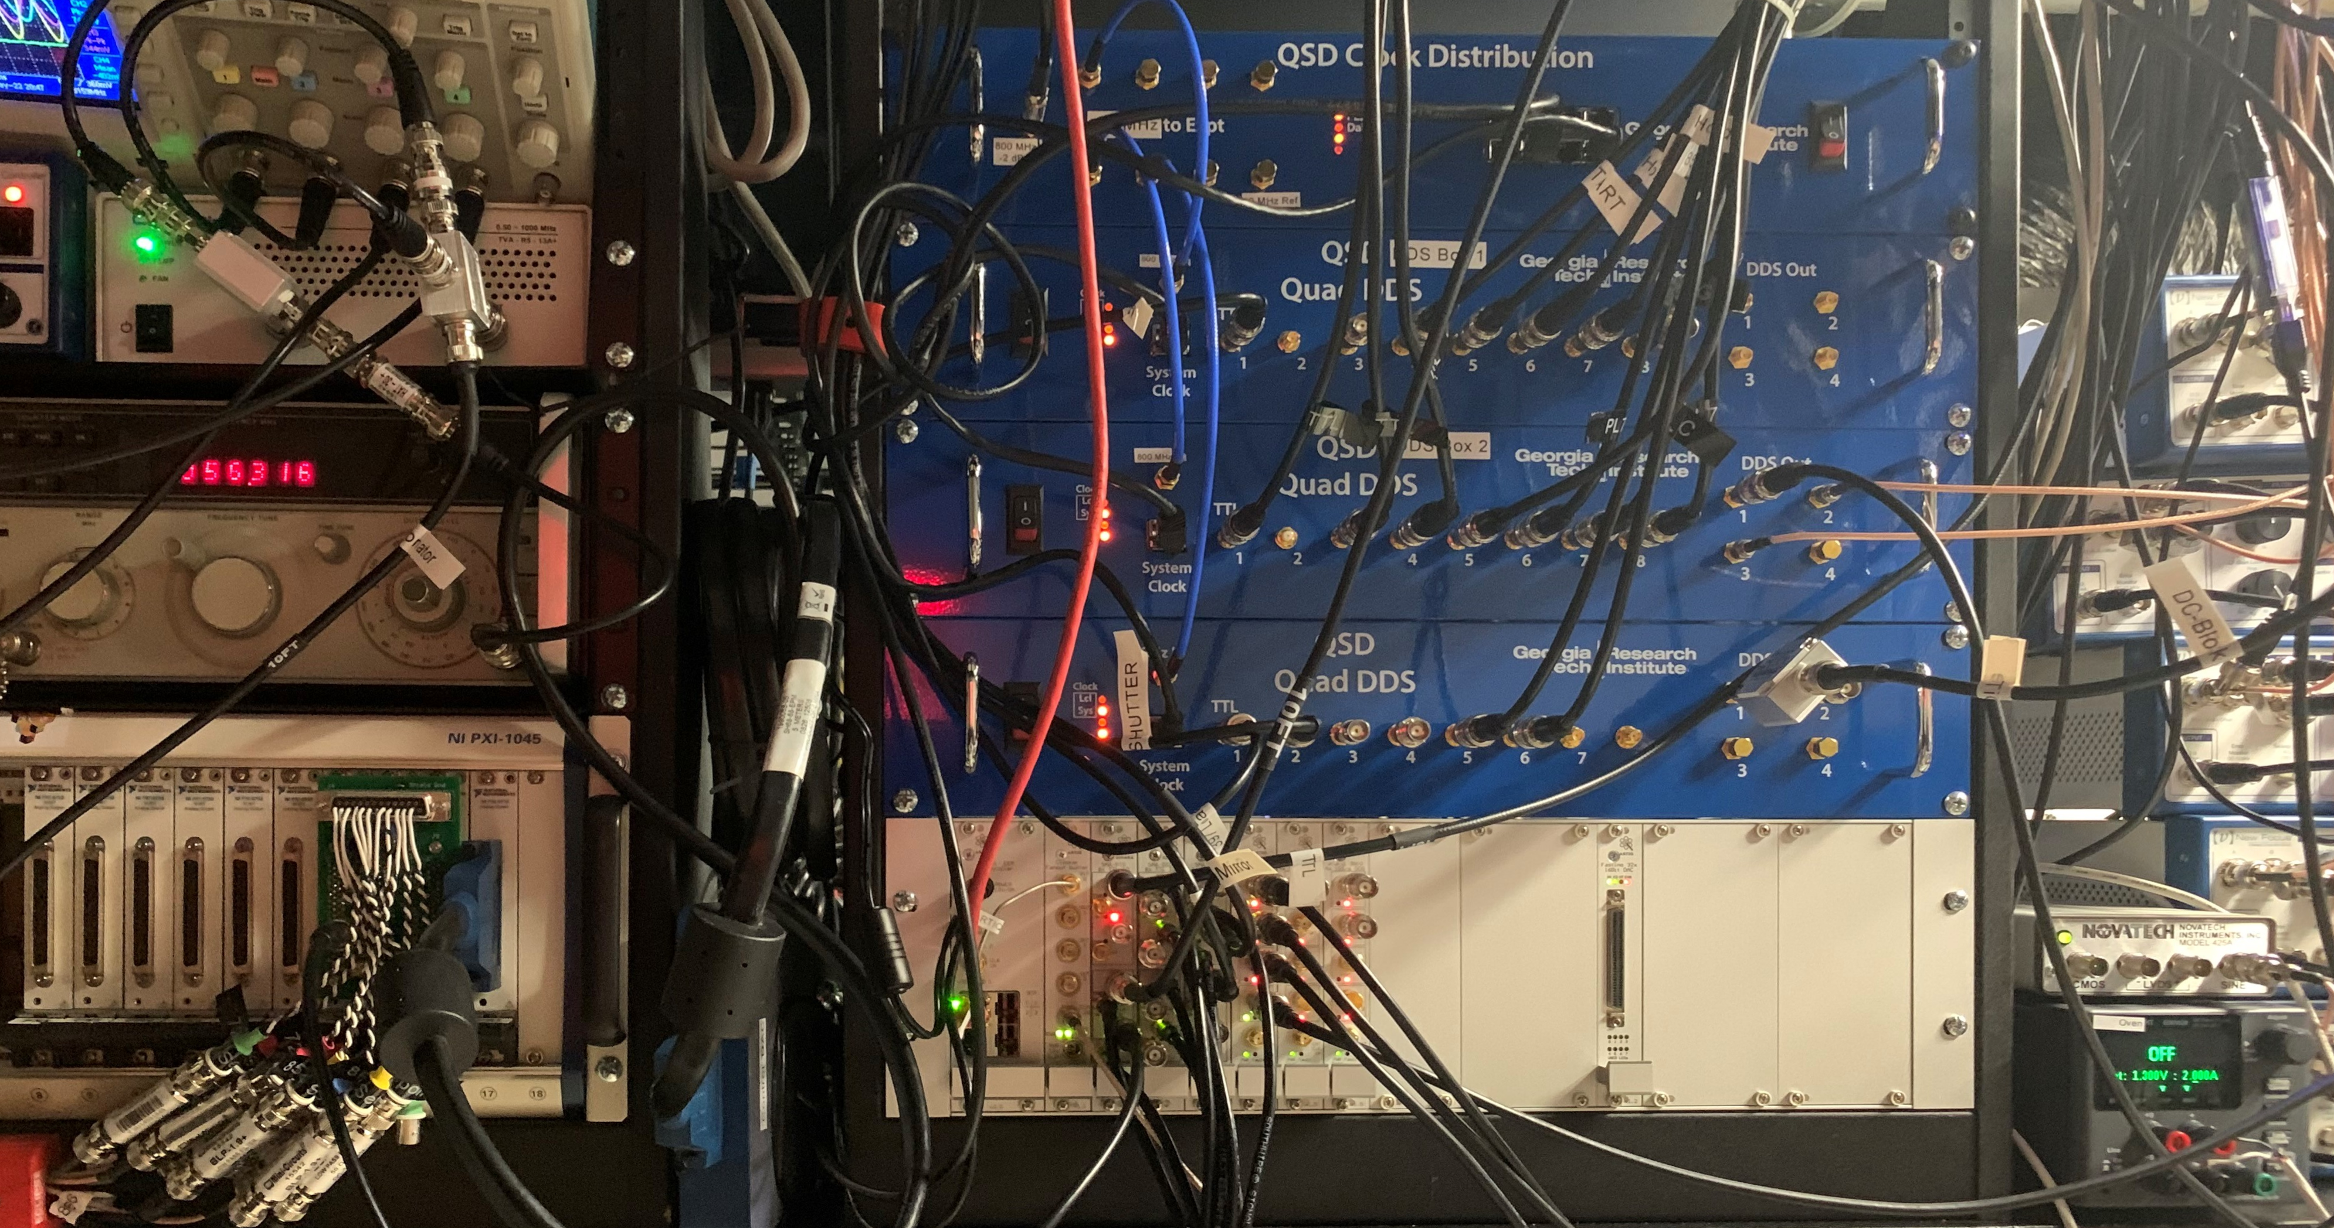
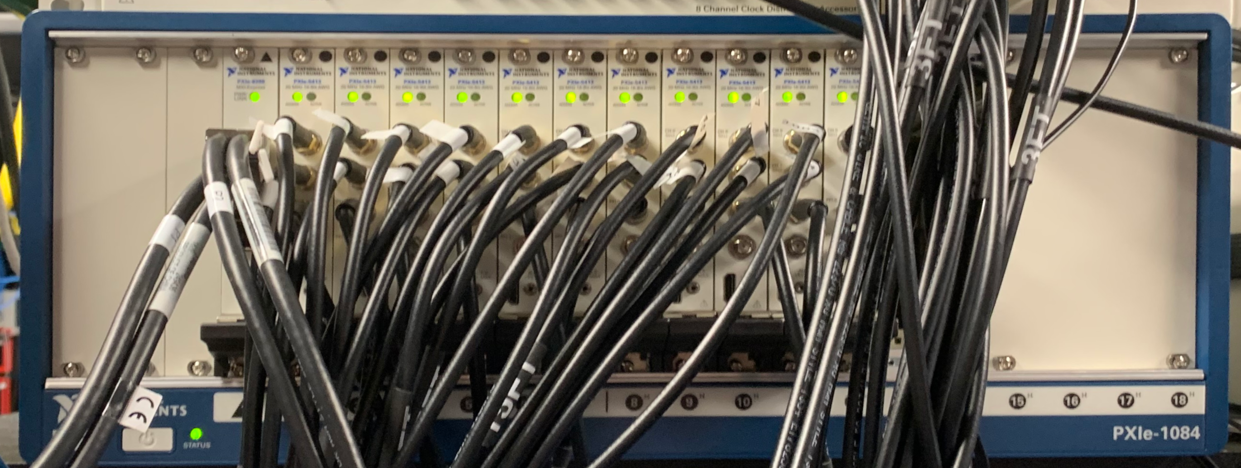
Migrating an Ion Trap Experiment to ARTIQ: Pitfalls and Community Contributions
Ryan A. McGill, Kenton R. Brown, Craig R. Clark, Brian J. McMahon
Georgia Tech Research Institute, Atlanta, GA 30318
ARTIQ Integration
Community Contributions
NI PXIe-5413
Arbitrary waveform generator that produces sequences to control trap electrode voltages
Keysight E36102B
DC power supply to operate calcium oven
Sinara 8ch TTL Card
ARTIQ FPGA controlled TTLs that are operable at ns timescales
Sinara “Urukul” DDS
ARTIQ FPGA controlled DDS for RF driving
NI PXI-6733
DAC used to control PID loop setpoints
Newport NewFocus 8742
Piezo-based motor to control lens translation stages
ARTIQ chassis | GTRI developed drivers
Equipment replaced by ARTIQ | Community developed drivers
Motivation for Converting to ARTIQ
Challenges
Documentation
Community advances sometimes go unlisted in main documentation
Difficult to track every change with multiple contributors
More likely to find specific help in the M-Lab forum or through user repositories
Documentation is brief and concise where verbosity would be desired
Debugging
Real-time input/output underflows (mismatch between FPGA timestamp and experiment scheduling) are very common occurrence in development
Built in core-analyzer allows insight into these errors, but can take time to uncover where these accumulations occur
COTS vs. Custom Built: Currently using a GTRI-built digital logic and DDS experiment control board
ARTIQ chassis provides a COTS solution which lends reconfigurability, allowing for future upgrades to the experiment station
Software Infrastructure: Experiments run on lab specific software can consume time to maintain and adapt as new hardware is added for experiments
ARTIQ comes with a high-level Python API, providing easy access to hardware both on and off chassis
Open-source software can reduce time maintaining core infrastructure
Shareable developments in experiments, device drivers, scanners, and GUIs across different user groups
Sub-microsecond Timing: Current solution is capable of executing pulses on the order of 10ns with lab-built hardware
ARTIQ allows for 8ns timing of pulses, with an available direct memory access (DMA) mode for fast execution
Next Steps:
GUI development
Wrap experiment control parameters into easily manageable GUIs, done through PyQT5 built into ARTIQ
Controller applets and scanners
Create scanning experiments that are easily deployable
High-level Experiment Modules
Consolidate common experiment sequences into documented Python libraries and modules
References:
Bourdeauducq, Sébastien et al. (2016). ARTIQ 1.0. Zenodo. 10.5281/zenodo. 51303.
.
Ryan.McGill@gtri.gatech.edu

